Slide 1



Rabi Flopping on a Magnetic Dipole Transition at Optical Frequencies
Nick Brewer
Zach Buckholtz
Zach Simmons
Eli Mueller
Deniz Yavuz
B
I

Slide 2
Outline
Introduction
Magnetic dipole transitions
Negative index of refraction
Experiment
Find a magnetic dipole transition
Experimental setup
Results
Spectral Hole Burning
Left-handed wave scheme

Slide 3
Magnetic Dipole Transitions
Not much magnetic response at optical frequencies
Magnetic transitions (M1) are fundamentally weaker than electric dipole transitions:
Atomic unit:
Notes:
Give comparison for uB - electron spin

Slide 4
Why do we care about M1 transitions?
Coherent responses of magnetic dipole transitions at optical frequencies have never been observed.
Refractive index engineering

Slide 5

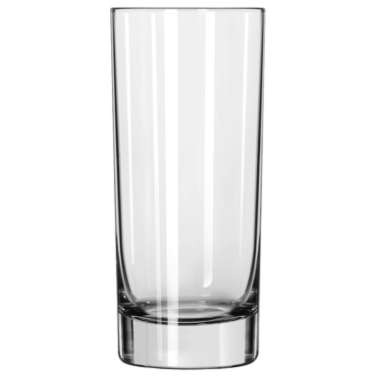
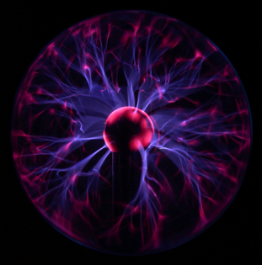
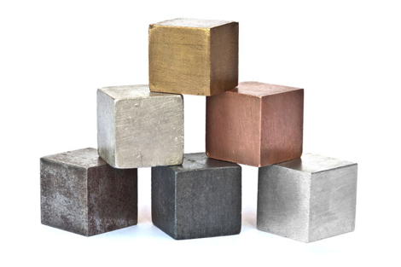

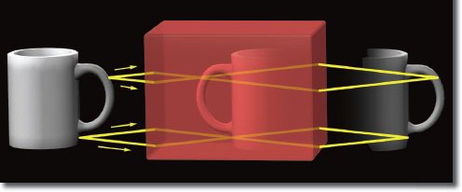
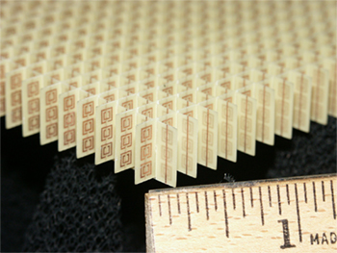


J. B. Pendry, et al, IEEE 1999

Slide 6
Left-Handed Light Properties
Negative refraction
Reversed Doppler effect
Radiation ‘tension’ rather than pressure
Notes:
Rai (MIT) comments:
- Explained classical radiation pressure picture. Explained in terms of ‘left-handed’ rule for poynting vector instead of using any momentum argument

Slide 7
Outline
Introduction
Magnetic dipole transitions
Negative index of refraction
Experiment
Finding a magnetic dipole transition
Experimental setup
Results
Spectral Hole Burning
Left-handed wave scheme

Slide 8
Finding Magnetic Dipole Transitions
Complex atomic structure
Inhomogeneous linewidths ~1 GHz
Homogeneous linewidths < 10 kHz

Slide 9
Atomic System: Eu⁺³:Y₂SiO₅
⁷F₀ → ⁵D₁ M1 optical transition (527.5 nm) ^{[1]}
Open 4f shell shielded by filled 5s, 5p shells
YSO field perturbs electrons very little
Studied in quantum memory experiments^{[2]}
Shen and Kachru, J. Opt. Soc. Am. B 1994
Lauritzen, et al, PRB 2012
Notes:
Rai (MIT) comments:
- Is the magnetic dipole due to spins or orbits?

Slide 10
Laser Set-Up
LHe Cryostat
(4.5 K)
Fiber Amplifier
Second Harmonic Generation Cavity
ECDL
1055 nm
AOM
~1.5 Watts of 527.5 nm
~50 kHz linewidth
PPKTP
Eu:YSO
Crystal
Reference Cavity
for Locking

Slide 11
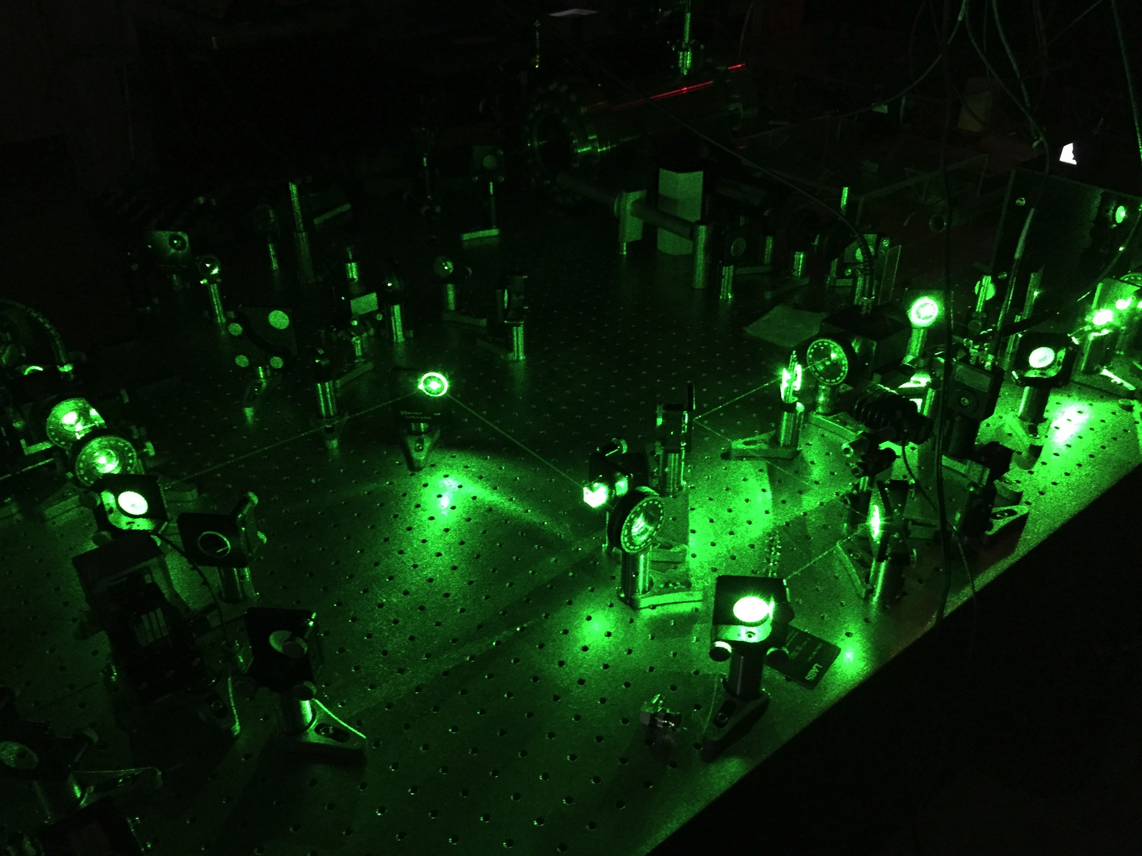

Slide 12
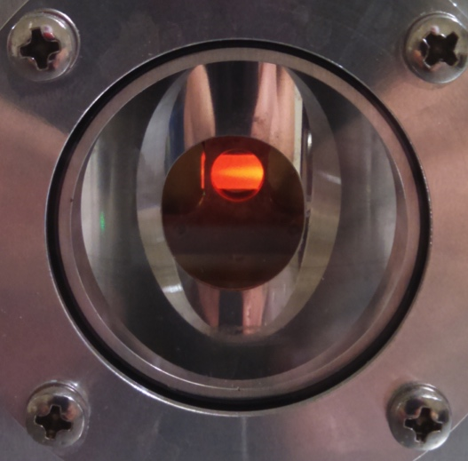
J
Notes:
Peter (MIT) comments:
- Line is broadened homogeneously from the phonons because it adds decreases lifetime

Slide 13
Verification of Magnetic Field Interaction with ⁷F₀ → ⁵D₁
Selection Rules for M1 transitions:
ΔJ=0, ± 1 (not J=0 → J=0)
No parity change
ΔS=±1→ ΔL=0, ±1, ±2
Novotny (PRL 2015) showed magnetic field excites ⁷F₀ → ⁵D₁ transition in Eu³⁺:Y₂O₃ using azimuthally polarized beam

Slide 14
Verification of Magnetic Field Interaction with ⁷F₀ → ⁵D₁
B-Field changing with respect to optical axis
E-Field changing with respect to optical axis
Notes:
Say crystal is anisotropic so a quantization axis is set up
Mention we do this same experiment with every combination of axis and polarization

Slide 15
Verification of Magnetic Field Interaction with ⁷F₀ → ⁵D₁
B-Field changing
Fluorescence (arb. units)
E-Field changing
Rotation Angle (degrees)

Slide 16
Rabi Oscillations
We want to measure μ so we have an idea of how well we can magnetize the material.
Measuring the Rabi frequency is a good way to do this

Slide 17
Rabi Oscillations
1
ρ_{e}
Time
Notes:
Mention stronger beam flops faster and weaker beam flops slower

Slide 18
Laser Set-Up
Photon
Counter
Fiber Amplifier
Second Harmonic Generation Cavity
LHe Cryostat
(4.5 K)
ECDL
1055 nm
AOM
Strong Beam
PPKTP
Eu:YSO
Crystal
Probe Beam
Reference Cavity
for Locking
AOM

Slide 19
Photon Counter
Probe Transmission
Pulse Time (μs)
Pick-off
Crystal

Slide 20
Photon Counter
Probe Transmission
Pulse Time (μs)
Pick-off
Crystal

Slide 21
5630 W/cm²
3160 W/cm²
Probe Transmission (arb. units)
4310 W/cm²
2000 W/cm²
3770 W/cm²
1510 W/cm²
Pulse Time (μs)
Notes:
Mention the dephasing is from inhomogeneous broadening and hyperfine structure

Slide 22
Determining the dipole moment

Slide 23
Calculated Dipole Moment:
Notes:
Boyd Comments:
The transition is actually pretty weak then?
- We make up for it in density
- We are sure it is a pure magnetic dipole with no or very little electric dipole contribution

Slide 24
×10⁻³
Probe Transmission (arb. units)
Data
Simulation
Pulse Time (μs)

Slide 25
×10⁻³
570 THz!
1 cm²
1 mA
Inferred Magnetization (A/m)
Pulse Time (μs)
Notes:
Boyd Comments:
-Magnetization of a ~1 T permanent magnetic is around ~1,000,000

Slide 26
Outline
Introduction
Magnetic dipole transitions
Negative index of refraction
Experiment
Find a magnetic dipole transition
Experimental setup
Results
Spectral Hole Burning
Left-handed wave scheme

Slide 27
Atomic Structure

Slide 28
Atomic Structure

Slide 29
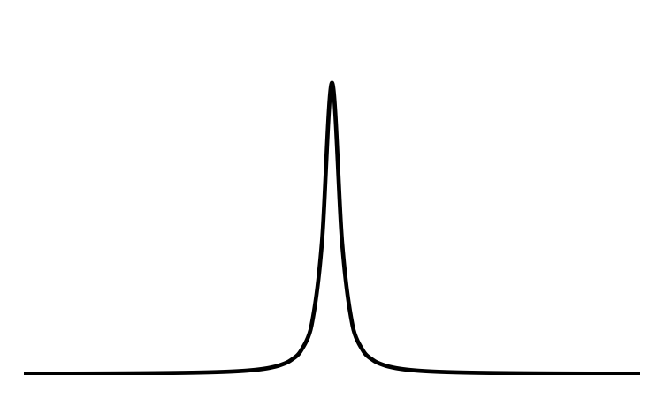
Causes of Dephasing – Hyperfine Structure
~100 MHz Hyperfine splitting
Transitions are shifted because of crystal field
Inhomogeneous linewidth is GHz wide

Slide 30
Causes of Dephasing – Hyperfine Structure
Notes:
Have branching ratio explanation ready

Slide 31
Causes of Dephasing – Inhomogeneous Broadening
1
Δ
Δ
Δ
ρ_{e}
Time

Slide 32
Spectral Hole Burning
δ₁
δ₂
Absorption
δ₁
δ₂
0
Detuning

Slide 33
Spectral Hole Burning
Absorption
0
Detuning

Slide 34
Spectral Hole Burning
Single class of ion to perform experiments:
Rabi Flopping
EIT
Absorption (arb. units)
Detuning (MHz)

Slide 35
Spectral Hole Burning - EIT
×10⁻⁵
2
1
Magnetic Susceptibility
-1
Frequency (kHz)
Notes:
EIT susceptibilities
-for now our X isn't too much, but we have another idea
Matt (MIT):
- Is absorption exactly zero or is there really a small amount of absorption?

Slide 36
Outline
Introduction
Magnetic dipole transitions
Negative index of refraction
Experiment
Find a magnetic dipole transition
Experimental setup
Results
Spectral Hole Burning
Left-handed wave scheme

Slide 37
A New Approach to LH Waves – External Polarization and Magnetization
In negative index materials ε and μ have a certain frequency response such that they are simultaneously negative
Write in terms of polarization and magnetization:
Apply external P and M to flip sign on RH side of equations
Notes:
Make clear this is a new approach with externally induced P and M
Mention that there are different ways we could externally polarize/magnetize, the easiest being a laser.
Boyd comments:
“the incident wave changes signs of ε and μ” ισ σλιγητλψ ινχορρεχτ ωορδινγ
Τρεψ χομμεντσ:
Ινστεαδ οφ πυττινγ ιν ανψ αμπλιτυδε οφ ωαϖε ανδ γεττινγ α λεφτ−ηανδεδ ωαϖε, τηε δριϖινγ φιελδσ αρε ωηατ δετερμινεσ τηε αμπλιτυδε

Slide 38
A New Approach to LH Waves – External Polarization and Magnetization
Left-Handed!
Notes:
These initial conditions are necessary to see pure left handed waves
Changes:
Changed top equations so they are solved for polarization and magnetization

Slide 40
A New Approach to LH Waves – External Polarization and Magnetization
No need to have a material with a true negative permeability
~100 nW/cm² of power with magnetization created in our current experiment

Slide 41
Externally Magnetizing and Polarizing Eu:YSO
4f⁶ ⁵D₁
4f⁶ ⁷F₀
Eu⁺³
YSO host crystal
Notes:
Porto Comments:
Is EFISH the same as stark shifting?

Slide 42
In Summary
Rabi Flopping
Large magnetization in atomic system
Next…
Spectral hole burning
Finding μ for each hyperfine transition
EIT – slow/stopped light
Combine magnetization and polarization to create left-handed waves

Slide 43


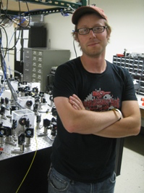

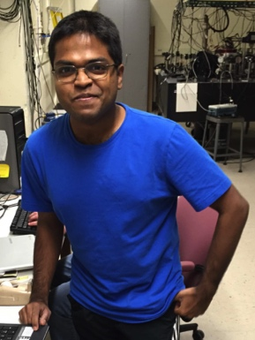
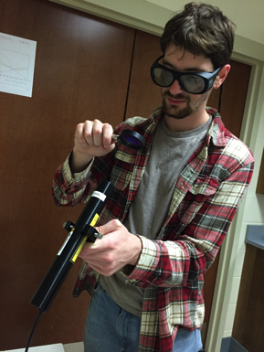

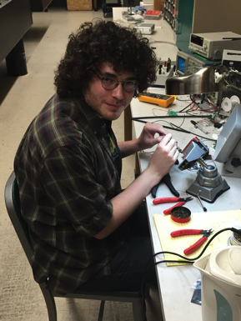
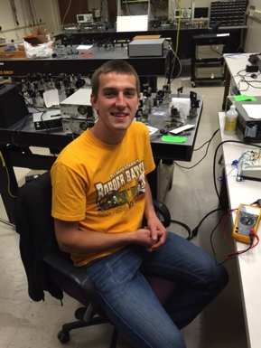
Lab Group
Deniz Yavuz
Advisor
Zach Buckholtz
Graduate Student
Zach Simmons
Past Graduate Student
Eli Mueller
Undergrad
Dipto Das
Graduate Student
David Gold
Graduate Student
Ben Lemberger
Graduate Student
Josh Karpel
Graduate Student

Slide 44
Solution to Dephasing
Spectral hole burning to select a narrowed population of ions
Nearby ions flop faster at a lower amplitude which washes out the signal
Optical pumping to prepare a ground state in a particular hyperfine level so only one transition is being flopped
There is a distribution of matrix elements between all possible transitions
Abs
Freq

Slide 45
×10⁻⁵
Magnetic Susceptibility
Frequency (GHz)

Slide 46
Absorption (arb. units)
Detuning (MHz)

Slide 47
Simulations – LH Wave Propagation in EPM Material
Pulse of polarization and magnetization:
Initial conditions:
t=0
t=1 fs
Electric Field
t=60 fs
x (μm)
Notes:
Mention finite difference method - Maxwell equations with no approximations

Slide 48
Simulations – LH Wave Propagation in EPM Material
t=0
t=1 fs
Electric Field
t=60 fs
x (μm)

Slide 49
Simulations – LH Wave Propagation in EPM Material
v_{g}, v_{p} parallel
Different from negative index material in which v_{g} and v_{p} are antiparallel
t=0
t=1 fs
Electric Field
t=60 fs
x (μm)

Slide 50
Simulations – LH Wave Propagation in EPM Material
t=0
Pulse of polarization and magnetization:
Initial conditions:
t=1 fs
Electric Field
t=30 fs
t=60 fs
right-handed
left-handed
x (μm)

Slide 51
Simulations – LH Wave Propagation in EPM Material
t=0
A right-handed wave is also created so that initial conditions are satisfied.
t=1 fs
Electric Field
t=30 fs
t=60 fs
right-handed
left-handed
x (μm)

